Slide 1
Daily Routine
Represented By:
Yashveer(1903410100047)
Lavkush chaudhary(19034101000)
Vineet Saraswat(19034101000)

Slide 2
Table of content
What is E-commerce website
Why use E-commerce
What is cloud computing
Purpose of project
Our services
Modules
Flow chart
Advantages of E-commerce
Disadvantages of E-commerce
Future updation

Slide 3
What is E-commerce
Commonly known as Electronic- marketing
It consists selling and buying goods services over the internet
E-commerce is the purchasing ,selling and exchanging goods and services over computer networks

Slide 4
Why use E-commerce… ??
Low Entry cost
Reduce transaction cost
Access the global market
Reduce the time

Slide 5
What is cloud computing
This allows organizations to scale faster and more efficiently without the burden of having to buy and maintain their own physical data centers and servers.
Cloud computing uses internet to connect users to a cloud platform where they request and access rented computing services.
It also solve the budget problem.

Slide 6
Purpose of project
Company can sells their product over internet and earn profit
Though the website we try to aware our customer for their Health and
Nature
Customer can buy the products easily and save their time

Slide 7
services
our website dealing with 2 services
Our website provide daily usable body cleaning products.
Our website also offering healthy food to the customers.

Slide 8
Modules
Home
Account
Contact
About
Products
Product details
Cart

Slide 9
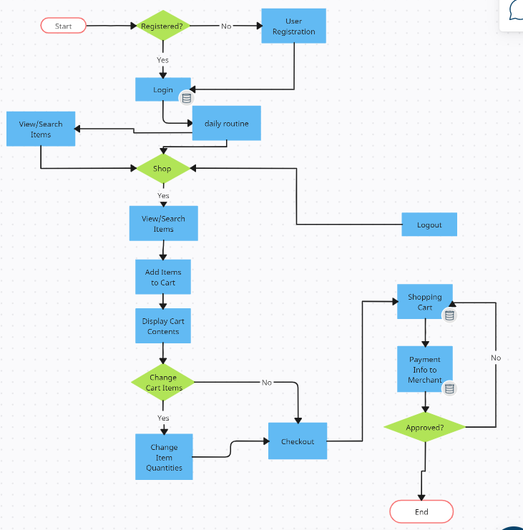
Flow chart

Slide 10
ADVANTAGES OF OUR WEBSITE
Faster buying/selling procedure
Easily find particular available products
Data store in cloud data base so buying/selling 24/7.
More reach to customers , there is no theoretical geographic limitations.
Easy and Friendly web interface.
Low operational costs and better quality of services.
Not depend on e-commerce products because of we
Are providing food services also.

Slide 11
DISADVANTAGES OF OUR WEBSITE
Not providing complete information of each product.
Food cart is not connected to body cleaner cart at the present time.
Not have admin penal.
Website opening time is little bit slow.

Slide 12
FUTURE UPDATION
Add new more products
Add new technologies
Add new or good thing so that the finding of product is easy for the user
Add new method for transactions

